Slide 1



OPEN
INNOVATION
CLIMATE CHANGE
-TEAM LAKSHYA

Slide 2

.
Point at issue:
Cities are constantly looking for ways to reduce energy consumption and improve the quality of life for their residents. Street lighting is a significant contributor to a city's energy expenditure, and it's essential to find efficient ways to manage and control street lights. An automated street lighting system is a common problem in smart city and energy efficiency projects. Finding lights on at daytime has become a common encounter, leading to over consumption of energy.
Description:
Design an automated street lighting system that optimizes energy usage.
The system should intelligently control when and how streetlights are turned on and off so as to control the harmful emision of greenhouse gases .
Maintain a record of consumption of energy and minimize light pollution.
By implementing these measures, an automated street lighting system can significantly reduce energy consumption, minimize light pollution, and contribute to a cleaner environment with lower air pollution levels.

Slide 3
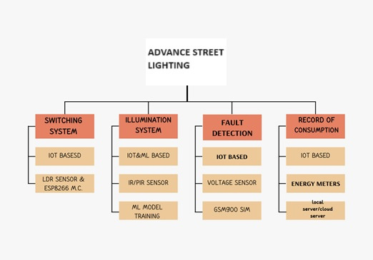
OUR IDEA IS-
THE POWER IS SUPPLIED BY SOLAR PANELS. THE MODEL IS HYBRID
DETECTION OF THE SUNLIGHT BY LDR SENSORS, AND WHEN THERE IS NO SUNLIGHT PRESENT THE LIGHT WILL TURN ON AUTOMATICALLY.DYNAMICAL ADJUSTMENT OF ILLUMINATION BY USING ML MODEL(XG BOOST ALGO) AND IOT EMBEDDED SYSTEMS
LIGHT SENSOR IS USED TO SENSE THE ENVIRONMENTAL CONDITIONS AND IR SENSOR IS USED TO SENSE THE MOTION ON THE PUBLIC ROADS,BY SENSING THIS THE ILLUMINATION WILL CHANGE ACCORDINGLY AS IT WILL DECREASE UPTO 50%,THIS IS HOW ENERGY CAN BE SAVED.
VOLTAGE SENSORS USED IN ENERGY METER IF IT DETECTS NO VOLTAGE DROP , IT WILL SEND A SIGNAL TO GSM900 TO CREATE A NOTIFICATION FOR RESPONSIBLE AUTHORITY.
COLLECTION OF DATA BY IOT GATEWAY FROM SENSORS AND THEN TRANSFER IT TO A CONTROL SYSTEM AND THEN TO A LOCAL SERVER.
A USER INTERFACE IS ALSO AVAILABLE TO VIEW STATS LIKE ENERGY CONSUMPTION, DETECTION OF DEFECTIVE LIGHTS , AND DATA STATS OF USER’S COMPLAIN.

Slide 4
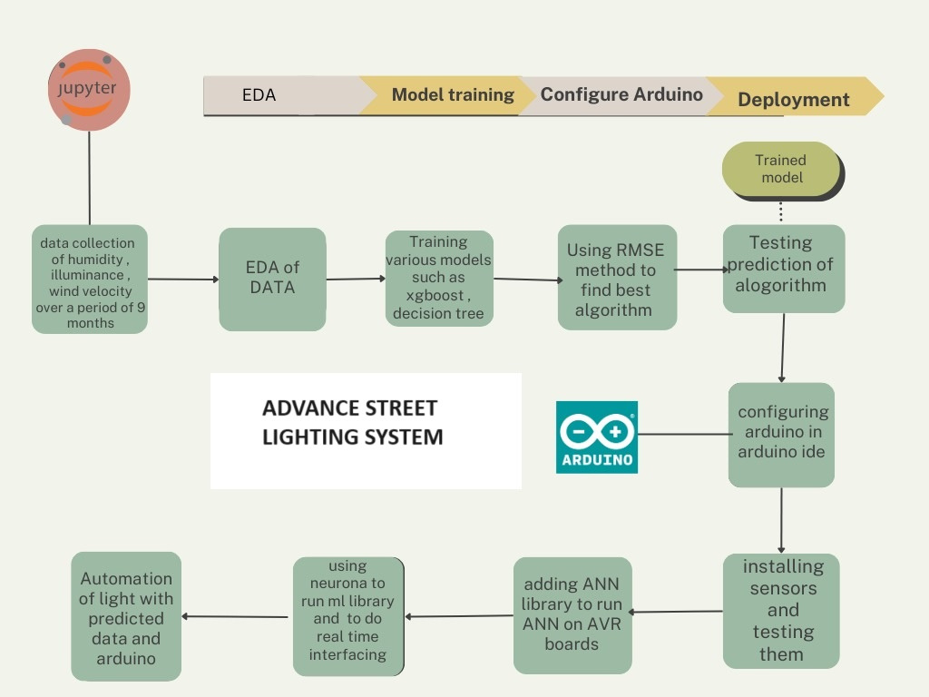
OUR IDEA IS-
LED Lighting: Replace traditional streetlights with energy-efficient LED lights. LEDs consume less energy thus decreasing light pollution.
Motion Sensors: Install motion sensors to adjust the lighting intensity based on traffic and pedestrian activity. This ensures that lights are only at full brightness when needed, reducing energy waste.
Daylight Sensors: Use daylight sensors to automatically adjust streetlight brightness based on natural light levels. This can further reduce energy consumption during daylight hours.
Timers: Set timers to turn off or reduce the intensity of streetlights during late-night hours when traffic is sparse. Consider gradually dimming lights as the night progresses.
Optimize Energy Usage: By promptly detecting and addressing issues, such as malfunctioning lights or unnecessary energy consumption, smart street lights help optimize energy usage and reduce carbon emissions.

Slide 5


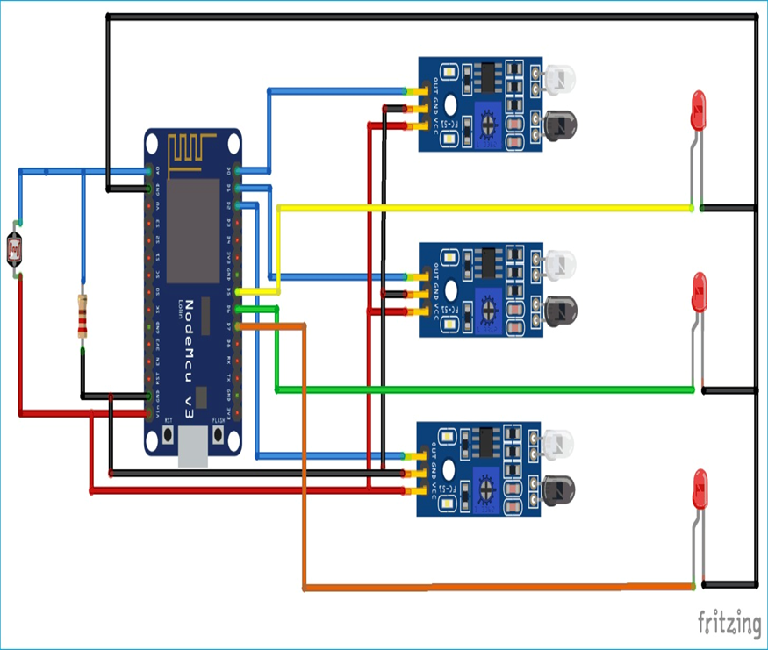
TECH STACK USED-
AUTOMATED SWITCHING AND
ILLUMINATION SYSTEM-

Slide 6

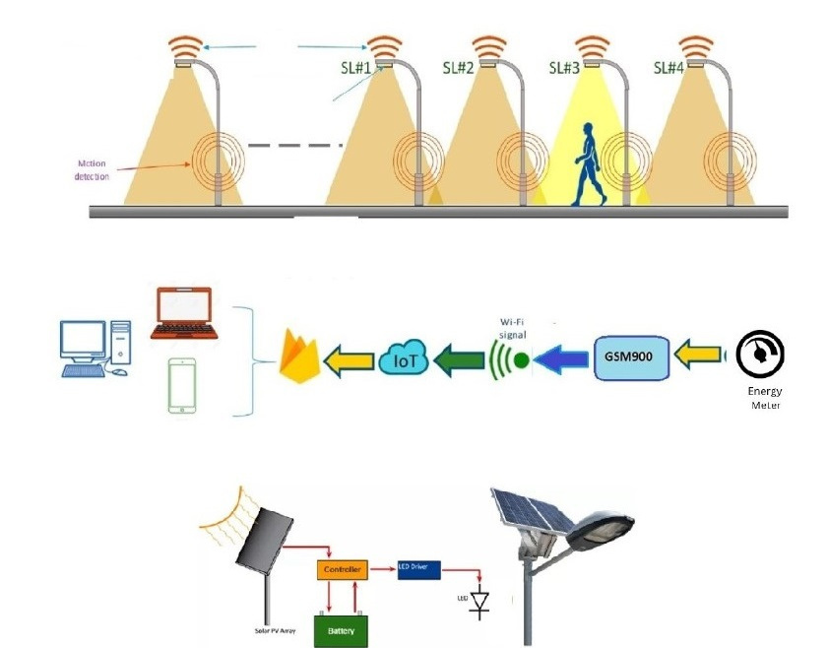

DEPENDENCIES-
ML MODELS TO CONTROL THE DYNAMIC ILLUMINATION OF THE LIGHT.
IOT DEVICES TO PREPARE A CENTRAL CONTROL SYSTEM FOR AUTOMATION.
SENSORS IN CONTROL OF AUTOMATION SYSTEM AND AND DETECTION OF
SUNLIGHT AND MOTIONS

Slide 7


Thank you!
TEAM LAKSHYA
AKASH PAL
AAYUSH RAGHAV
NIYATI JAIN
VAISHNAVI GUPTA

